Slide 1
PROJECT STATUS REPORT
VEHICLE PARKING MANAGEMENT SYSTEM
M.JAGANATHAN
56135

Slide 2
PROJECT OVERVIEW
What is the project about?
1)Creating a dynamic web application
2)AAYL(Apply As You Learn) Project
Define the goal of this project
1)Dynamic Web Application for the regular visitors of IT park or Mall or Theatres or any places where parking is a great deal.
Define the scope of this project
1)Can be used in all the public places where group of people meet.

Slide 3
CURRENT STATUS
BACKEND
FRONTEND
INTEGRATION
What progress has been made since the previous milestone?
Which tasks have been completed?
1)Modelling and Designing of Project in UML
2)Creation of required tables in Derby Database
Is the project currently ahead of schedule, on track, or delayed?
The project is currently on track

Slide 4
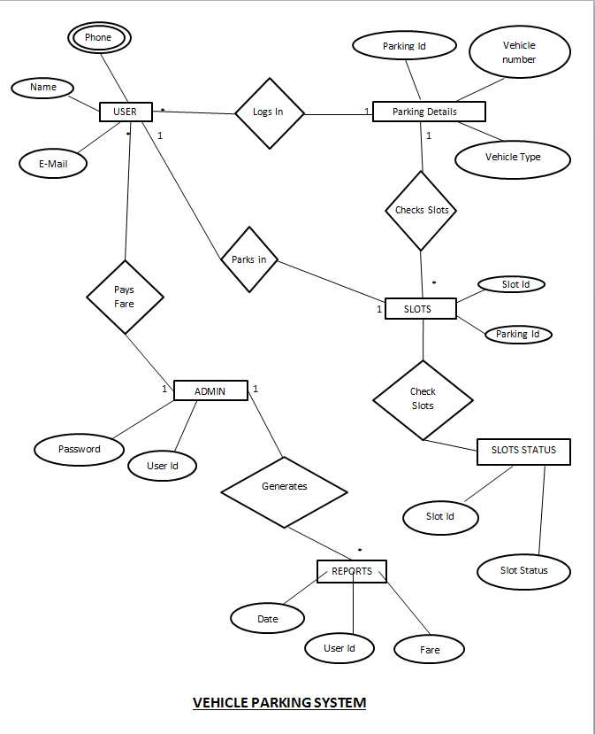
ER DIAGRAM

Slide 5
TECHNOLOGIES USED
FRONT END
BOOTSTRAP
BACK END
JAVA
HTML
CSS
JS
SQL
SERVLETS
DERBY DATABASE
ORACLE SERVER
ANGULAR JS

Slide 6
Issues and Resolutions
Description of the issue
In modelling the project , like Where to start with ?
How was it resolved?
Using Class Diagram to get a complete picture of the project
Approaching the problem in a modular way.
What and how did it impact the project?
Time : Took about one to two weeks to model the project
Cost : No cost impact

Slide 7
Timeline
Modelling
30/01/2017
Class Diagram
ER Diagram
App
Database Integration
20/02/2017
SQL
JDBC
Java Source Code
09/02/2017
Bean
DAO
UI DESIGN
23/03/2017
HTML
CSS,BOOTSTRAP
SERVLETS
JS
SPRING

Slide 8
LOOKING AHEAD
When is the next milestone?
To test the web application(Both Manual and Automatic testing-JUnit)
What are the expected deliverables?
A Web Application to facilitate parking
Known risks and issues
Security is the major issue
Allocation of slots and updation

Slide 9
User Interface Screenshots

Slide 10
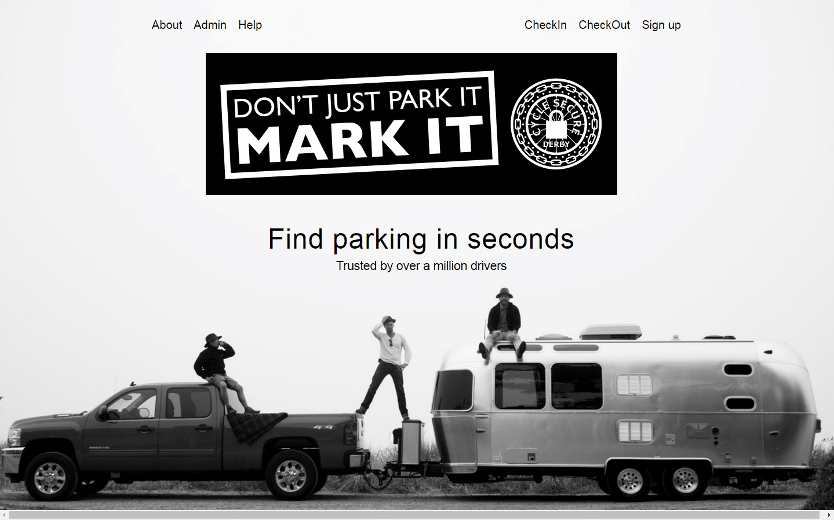

Slide 11
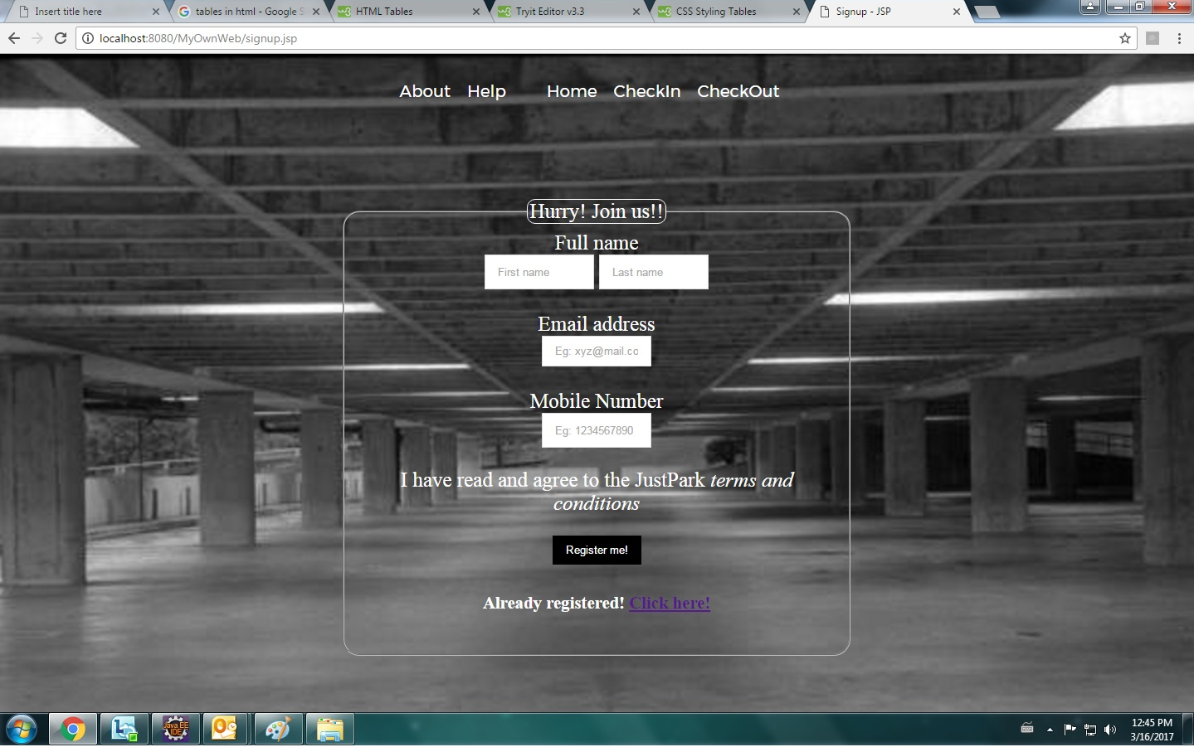

Slide 12
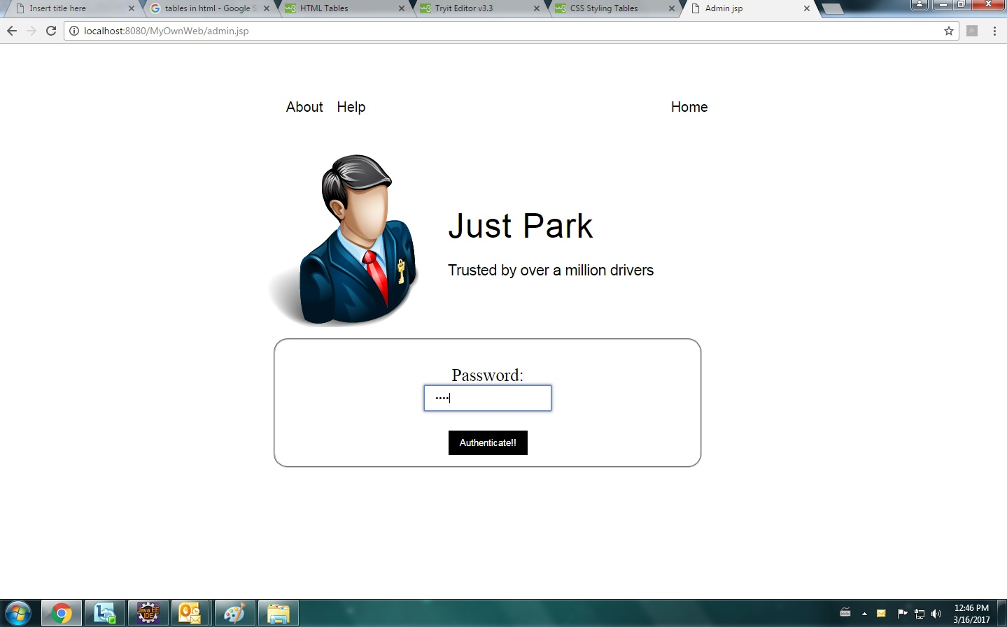

Slide 13
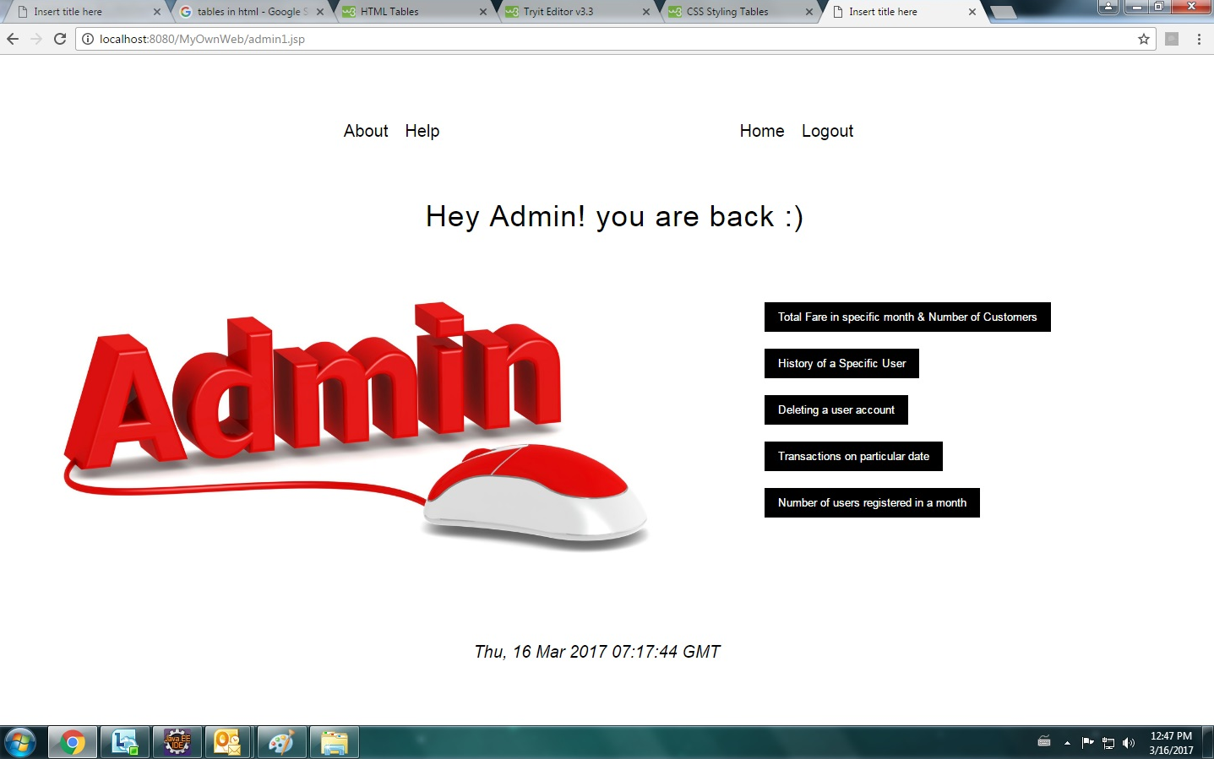

Slide 14
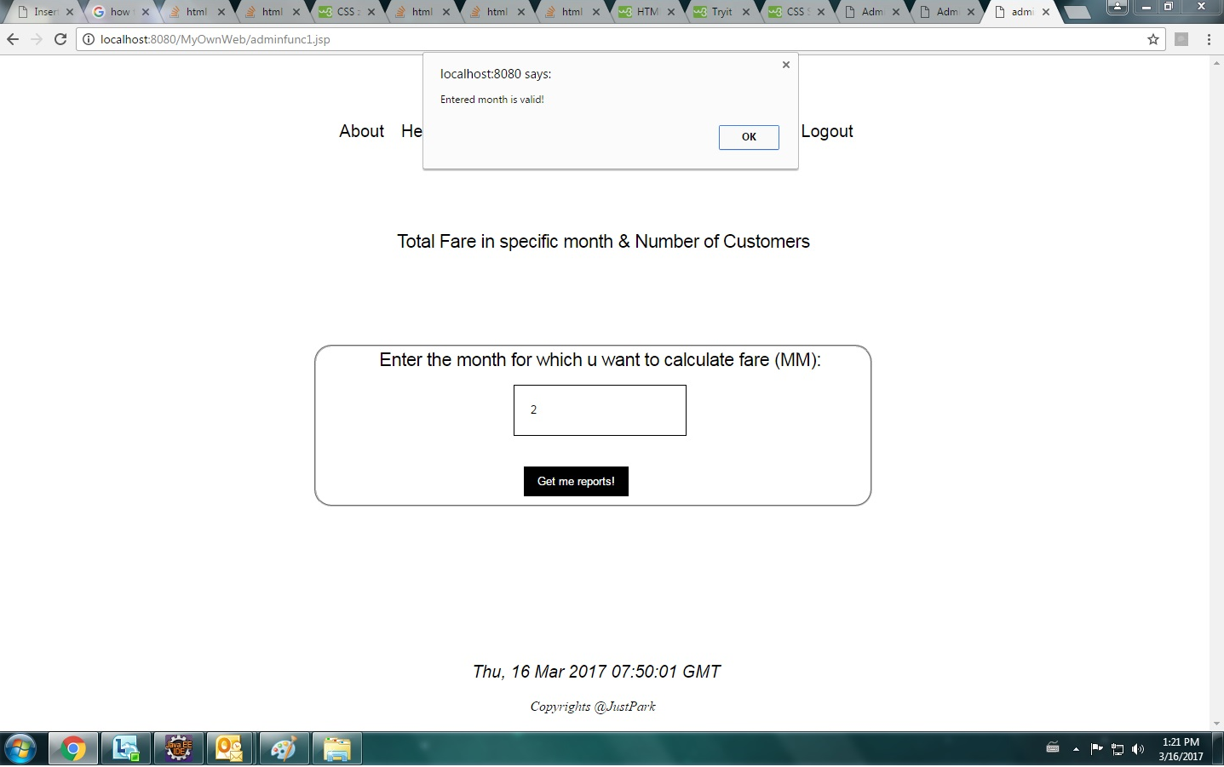

Slide 15
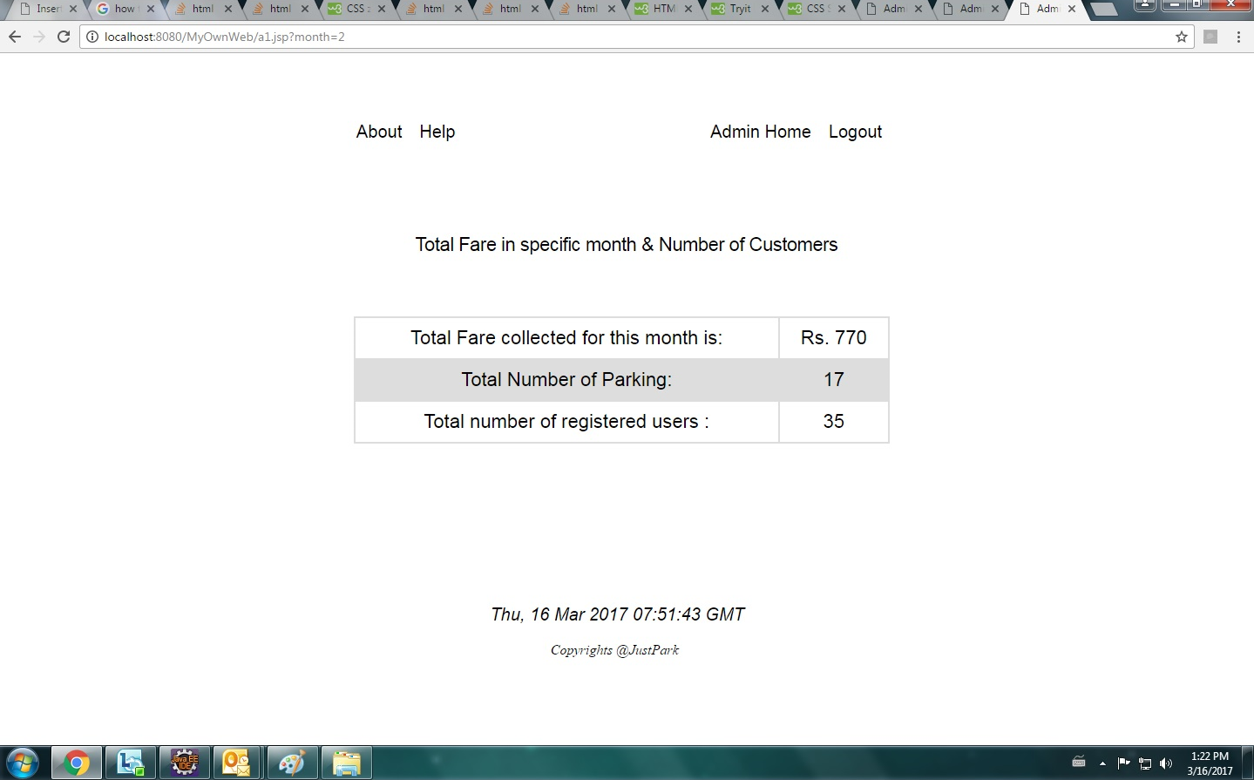

Slide 16
CODE SAMPLE

Slide 17
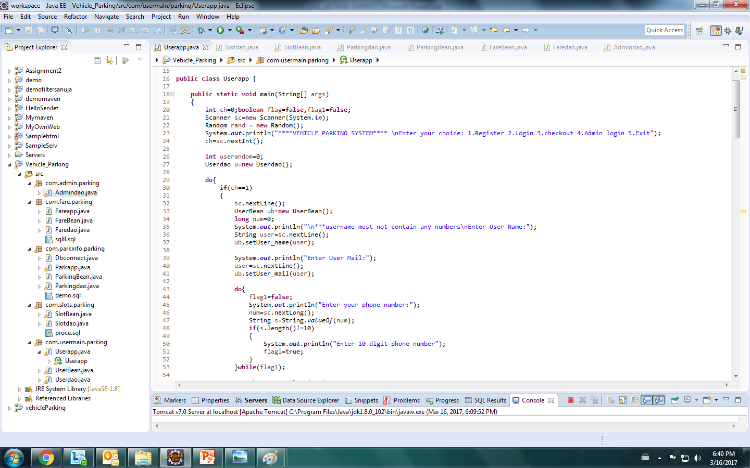

Slide 18
Company Project

Slide 19
PLATFORM
NEXEN
FLEXIBLE CLIENT CENTRIC PLATFORM
DATA-DRIVEN INSIGHT
INTELLIGENT OPEN ARCHITECTURE
BUSINESS SOLUTIONS
GLOBAL INNOVATION CENTER
THE CLOUD
NEXEN – An open-source, cloud-based technology platform
NEXEN is designed to empower company clients to change the way they operate to be more flexible, efficient and fast.
Provides data-driven insights to empower clients to make evidence-based decisions faster.

Slide 20
THANK YOU!

